Slide 1
Team 1- ptds- regression project
Samukelisiwe Ndaba
Madelein Pretorius
Boitumelo Modirapula
Tiny Kekana

Slide 2
Project Overview Global warming, Climate change, and Human health are getting impacted due to excessive agri-food emissions. Hence, the predictive analysis of average temperature increase that is caused by the CO2 emissions from agri-food activities is important for policymakers and researchers to develop strategies for sustainable agricultural practices. This project explores historical data on agri-food CO2 emissions and it's impact on the increase of temperature in various countries around the world for a time span of 30 years (1990–2020). Since there is a need for predicting emission from the agri-food sector and corresponding temperature increase, this project explores this area by implementing the three predictive models Linear Regression, Decision Trees, Random Forests. Exploratory data analysis (EDA) helps to understand the descriptive statistics, and data visualizations on agri-food activities, emissions, temperature rise, and their relationships. The three predictive models are trained and measured with metrics like MSE, RMSE, MAE, and R-squared. The Linear Regression model emerged as the best model with the highest predictive accuracy, with the lowest RMSE, MAE and highest R2-score for CO2 emissions. The project concludes that Linear Regression can serve as a robust tool in predicting temperature increase from CO2 emissions from agri-food activities and helps the policymakers, government bodies, and sustainable environment by providing useful insights and strategies to reduce the environmental impact of agriculture
This Project Aims to:
Understand the relationship between Temperature rise and CO2 emission deriving from the agri-food sector activities.
Extensively investigate the relationship amongst an extensive list of agri-food processes CO2 emissions and average temperature rise.
Identify any potential correlations between the agri-food sector emissions and average temperature increase.

Slide 3
Import Packages
#importing the necessary libraries
import pandas as pd
import numpy as np
import matplotlib.pyplot as plt
import seaborn as sns
import plotly.graph_objects as go
from sklearn.preprocessing import MinMaxScaler
from sklearn.preprocessing import LabelEncoder
from sklearn.model_selection import train_test_split
from sklearn.linear_model import LinearRegression
from sklearn.ensemble import RandomForestRegressor
from sklearn.metrics import mean_absolute_error,mean_squared_error, r2_score
from sklearn.feature_selection import SelectKBest, f_classif
from sklearn.tree import DecisionTreeRegressor
import warnings
warnings.filterwarnings("ignore")
from sklearn.experimental import enable_iterative_imputer # We need .experimental, .impute, .linear_model for data imputation using the MICE framework.
from sklearn.impute import IterativeImputer
from sklearn.preprocessing import MinMaxScaler

Slide 4
Average Temperature Table- Data Clean up
Area | Year | Savanna fires | Forest fires | Crop Residues | Rice Cultivation | Drained organic soils (CO2) | Pesticides Manufacturing | Food Transport | Forestland | ... | Manure Management | Fires in organic soils | Fires in humid tropical forests | On-farm energy use | Rural population | Urban population | Total Population - Male | Total Population - Female | total_emission | Average Temperature °C
Afghanistan | 1990 | 14.7237 | 0.0557 | 205.6077 | 686.00 | 0.0 | 11.807483 | 63.1152 | -2388.803 | ... | 319.1763 | 0.0 | 0.0 | NaN | 9655167.0 | 2593947.0 | 5348387.0 | 5346409.0 | 2198.963539 | 0.536167
Afghanistan | 1991 | 14.7237 | 0.0557 | 209.4971 | 678.16 | 0.0 | 11.712073 | 61.2125 | -2388.803 | ... | 342.3079 | 0.0 | 0.0 | NaN | 10230490.0 | 2763167.0 | 5372959.0 | 5372208.0 | 2323.876629 | 0.020667
Afghanistan | 1992 | 14.7237 | 0.0557 | 196.5341 | 686.00 | 0.0 | 11.712073 | 53.3170 | -2388.803 | ... | 349.1224 | 0.0 | 0.0 | NaN | 10995568.0 | 2985663.0 | 6028494.0 | 6028939.0 | 2356.304229 | -0.259583
Afghanistan | 1993 | 14.7237 | 0.0557 | 230.8175 | 686.00 | 0.0 | 11.712073 | 54.3617 | -2388.803 | ... | 352.2947 | 0.0 | 0.0 | NaN | 11858090.0 | 3237009.0 | 7003641.0 | 7000119.0 | 2368.470529 | 0.101917
Afghanistan | 1994 | 14.7237 | 0.0557 | 242.0494 | 705.60 | 0.0 | 11.712073 | 53.9874 | -2388.803 | ... | 367.6784 | 0.0 | 0.0 | NaN | 12690115.0 | 3482604.0 | 7733458.0 | 7722096.0 | 2500.768729 | 0.37225

Slide 5
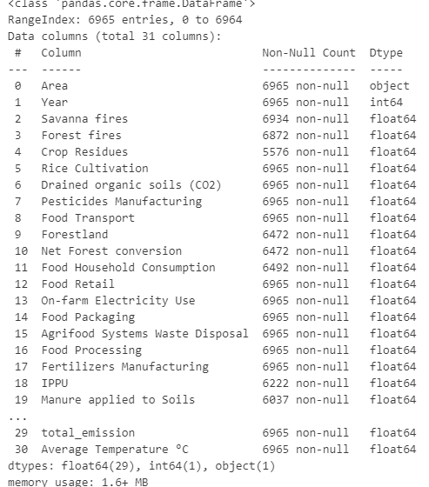
Pandas Data frame

Slide 6
Exploratory Data Analysis (EDA)
 | YEAR | SAVANNA_FIRES | FOREST_FIRES | CROP_RESIDUES | RICE_CULTIVATION | DRAINED_ORGANIC_SOILS_(CO2) | PESTICIDES_MANUFACTURING | FOOD_TRANSPORT | FORESTLAND | NET_FOREST_CONVERSION | ... | MANURE_MANAGEMENT | FIRES_IN_ORGANIC_SOILS | FIRES_IN_HUMID_TROPICAL_FORESTS | ON-FARM_ENERGY_USE | RURAL_POPULATION | URBAN_POPULATION | TOTAL_POPULATION_-_MALE | TOTAL_POPULATION_-_FEMALE | TOTAL_EMISSION | AVERAGE_TEMPERATURE_°C
count | 6965.000000 | 6934.000000 | 6872.000000 | 5576.000000 | 6965.000000 | 6965.000000 | 6965.000000 | 6965.000000 | 6472.000000 | 6.472000e+03 | ... | 6037.000000 | 6965.000000 | 6810.000000 | 6009.000000 | 6.965000e+03 | 6.965000e+03 | 6.965000e+03 | 6.965000e+03 | 6.965000e+03 | 6965.000000
mean | 2005.124910 | 1188.390893 | 919.302167 | 998.706309 | 4259.666673 | 3503.228636 | 333.418393 | 1939.581760 | -17828.285678 | 1.760564e+04 | ... | 2263.344946 | 1210.315532 | 668.452931 | 3008.982252 | 1.785774e+07 | 1.693230e+07 | 1.761963e+07 | 1.732447e+07 | 6.409124e+04 | 0.872989
std | 8.894665 | 5246.287783 | 3720.078752 | 3700.345330 | 17613.825187 | 15861.445678 | 1429.159367 | 5616.748808 | 81832.210543 | 1.011575e+05 | ... | 7980.542461 | 22669.847760 | 3264.879486 | 12637.864430 | 8.901521e+07 | 6.574362e+07 | 7.603993e+07 | 7.251711e+07 | 2.283130e+05 | 0.555930
min | 1990.000000 | 0.000000 | 0.000000 | 0.000200 | 0.000000 | 0.000000 | 0.000000 | 0.000100 | -797183.079000 | 0.000000e+00 | ... | 0.432900 | 0.000000 | 0.000000 | 0.031900 | 0.000000e+00 | 0.000000e+00 | 2.500000e+02 | 2.700000e+02 | -3.918841e+05 | -1.415833
25% | 1997.000000 | 0.000000 | 0.000000 | 11.006525 | 181.260800 | 0.000000 | 6.000000 | 27.958600 | -2848.350000 | 0.000000e+00 | ... | 37.632100 | 0.000000 | 0.000000 | 13.291900 | 9.731100e+04 | 2.173860e+05 | 2.013260e+05 | 2.078900e+05 | 5.221244e+03 | 0.511333
50% | 2005.000000 | 1.651850 | 0.517900 | 103.698200 | 534.817400 | 0.000000 | 13.000000 | 204.962800 | -62.920000 | 4.444000e+01 | ... | 269.856300 | 0.000000 | 0.000000 | 141.096300 | 1.595322e+06 | 2.357581e+06 | 2.469660e+06 | 2.444135e+06 | 1.214765e+04 | 0.834300
75% | 2013.000000 | 111.081400 | 64.950775 | 377.640975 | 1536.640000 | 690.408800 | 116.325487 | 1207.000900 | 0.000000 | 4.701746e+03 | ... | 1126.818900 | 0.000000 | 9.577875 | 1136.925400 | 8.177340e+06 | 8.277123e+06 | 9.075924e+06 | 9.112588e+06 | 3.513973e+04 | 1.206750
max | 2020.000000 | 114616.401100 | 52227.630600 | 33490.074100 | 164915.255600 | 241025.069600 | 16459.000000 | 67945.765000 | 171121.076000 | 1.605106e+06 | ... | 70592.646500 | 991717.543100 | 51771.256800 | 248879.176900 | 9.000991e+08 | 9.020778e+08 | 7.435866e+08 | 7.133419e+08 | 3.115114e+06 | 3.558083

Slide 7
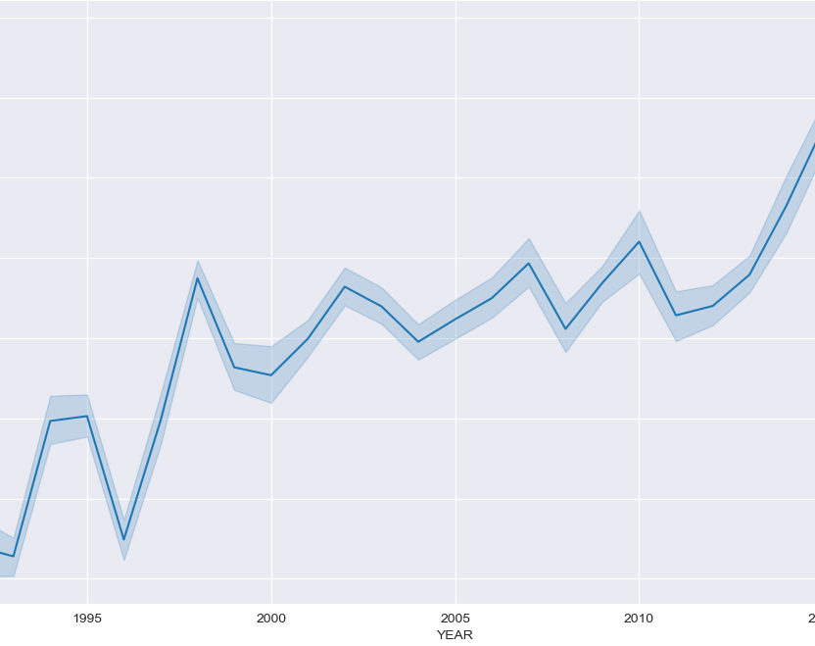
Average temperature Time Series
Since 1990, the average land temperature line, compared to pre-industrial times, showcases an upward trend, hitting an all time high of approximately 1.5°C in 2020.

Slide 8
If the values are not standardized, we won't be able to plot the lines in the same graph, as the scales will be totally different.
from sklearn.preprocessing import MinMaxScaler # Import min-max scaler. This will transform all the variable to take values between 0 and 1.
scaler = MinMaxScaler() #let's instantiate it.
temp_emission = df.groupby("YEAR").agg({"AVERAGE_TEMPERATURE_°C": "mean", "TOTAL_EMISSION": "mean", 'URBAN_POPULATION': 'mean'}) # let's calculate
#the mean emission,
#population and temperature per year
norm_emission= scaler.fit_transform(temp_emission) #Here we transform the mean values using the scaler.
temp_df = pd.DataFrame(norm_emission, columns = ['Standardized Avg Temperature','Standardized Mean CO2 emission', 'Standardized Mean Urban Population']) #because the scaler outputs
##Nparrays, let's create a df.
temp_df.index = [i for i in range(1990, 2021)] # the data were grouped by year and hence, we can use the year as index. The starting year is 1990 and the end year 2020
fig, ax = plt.subplots(figsize = (10,6)) # Let's set our figure and axes
g = sns.lineplot(temp_df, ax = ax) #Use seaborn because its looking cool
fig.suptitle('Normalized CO2 Emission, Temperature, urban population')
plt.plot() # and plot

Slide 9
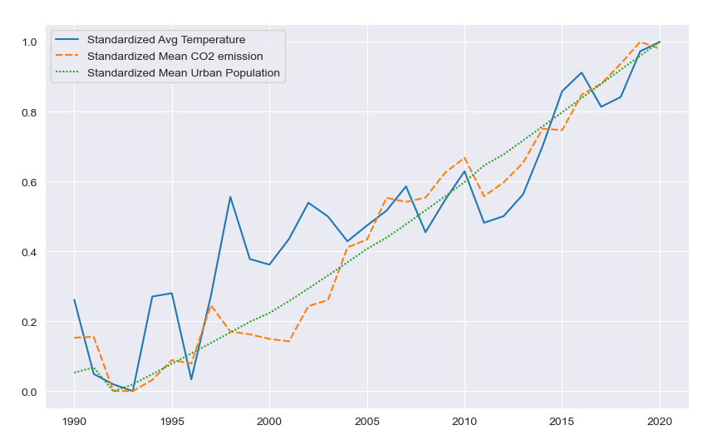
Normalized CO2 Emission,Temperature,urban population
The graph shows that CO2 emission, mean urban population and average temperature go hand in hand. All three lines show a strong upward trend.

Slide 10
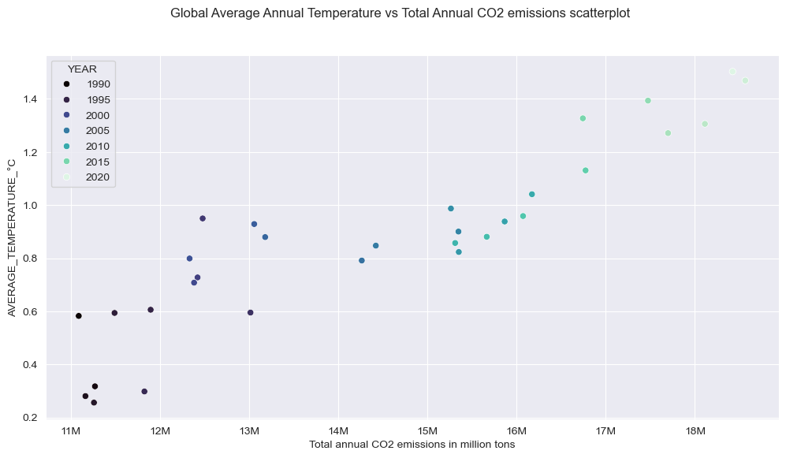
Total emissions and temperature are gradually increasing over time which indicates a potential correlation between them. Both CO2 emissions and temperature continue to rise sharply in recent years, indicating ongoing environmental challenges with respect to global warming and greenhouse gas emissions.

Slide 11
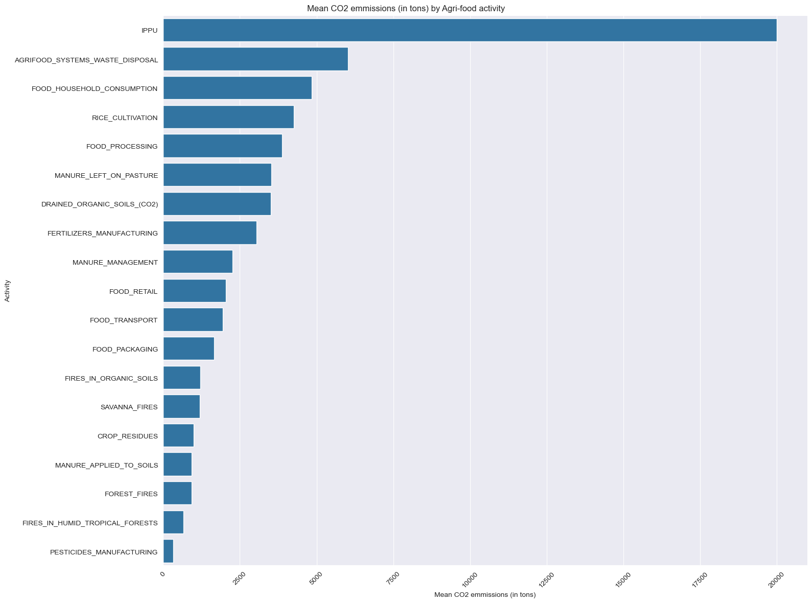
The above graph shows that IPPU is by far the activity with the most CO2 emissions, followed by emissions coming from waste disposal and agrifood products consumption. Thereafter, other industrial and cultivation activities follow, with fire emissions coming towards the end

Slide 12
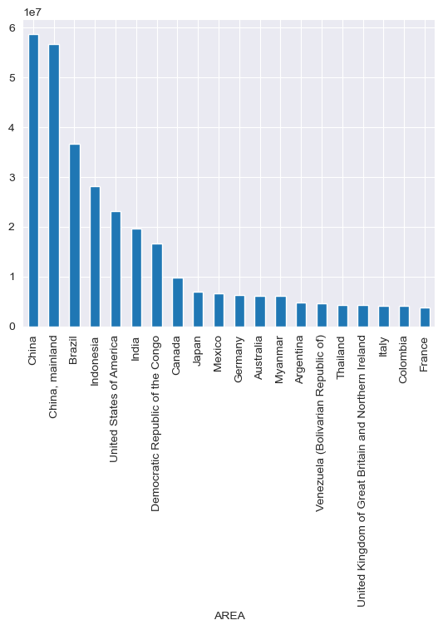
The graph above shows that China has the highest CO2 emission, followed by Brazil,Indonesia and USA.

Slide 13
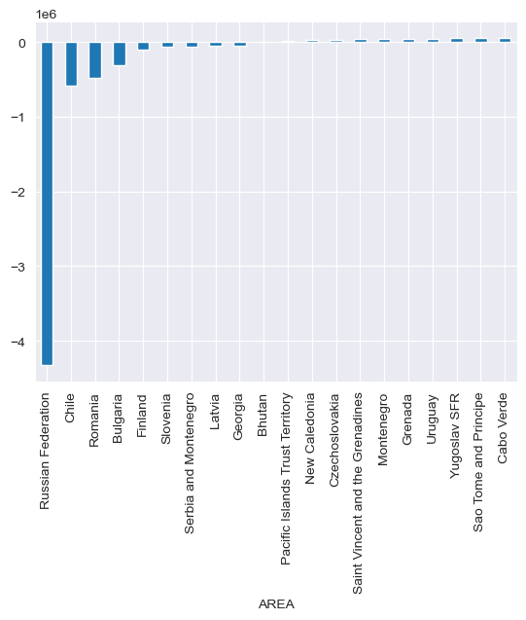
This graph shows that Russia has the lowest CO2 emission.

Slide 14
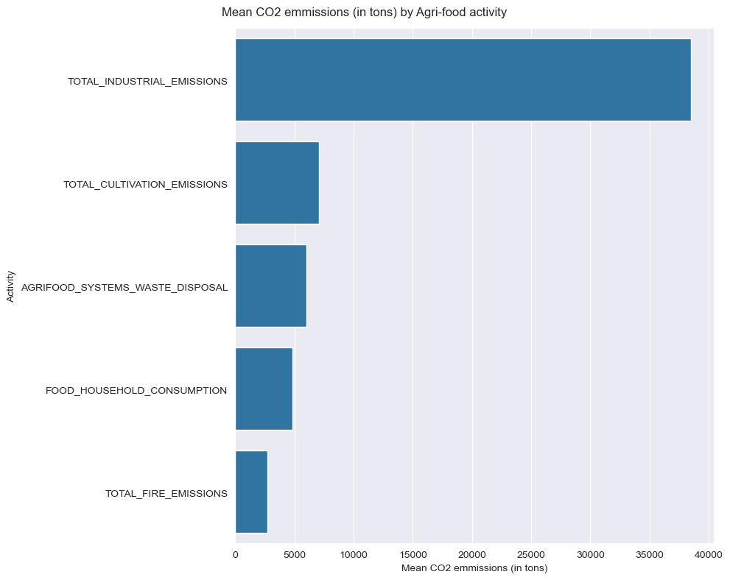
The bar chart above shows that industrial activities emit the biggest proportion of CO2, followed by cultivation emissions (as opposed to waste disposal emissions), which in turn are followed by waste disposal emissions, consumption emissions, and fire emissions.

Slide 15
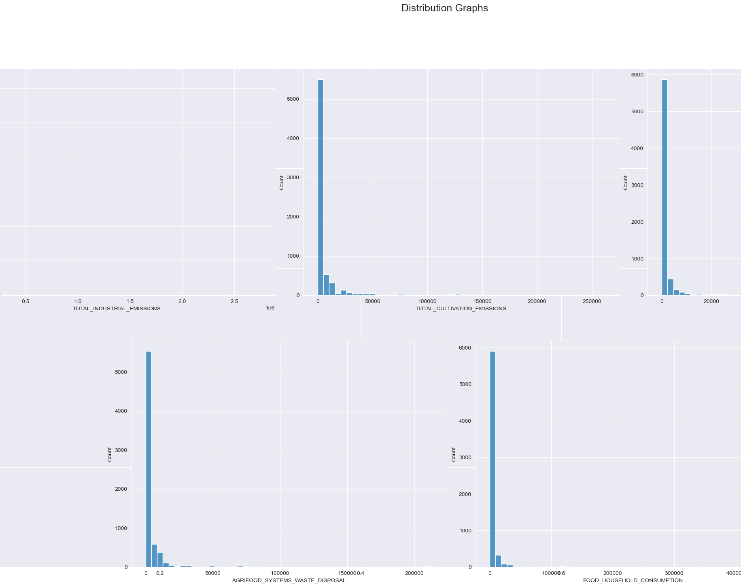
Distribution Graphs
The data are negatively skewed for all emission categories. This means that the histograms have a long right tail. The underlying reason for this behavior might be that the must majority of countries have a small or moderate agrifood sector and hence the emissions are much lower in comparison to agrifood and industrial giants such as China, the USA or Brazil.

Slide 16
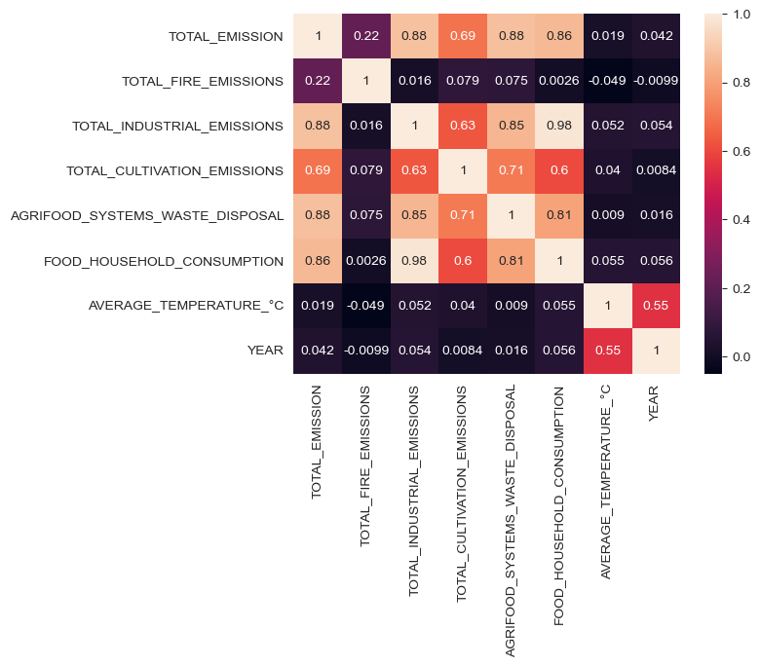
Text(0.5, 0.98, 'Critical variables aggregated by year scatterplot'

Slide 17
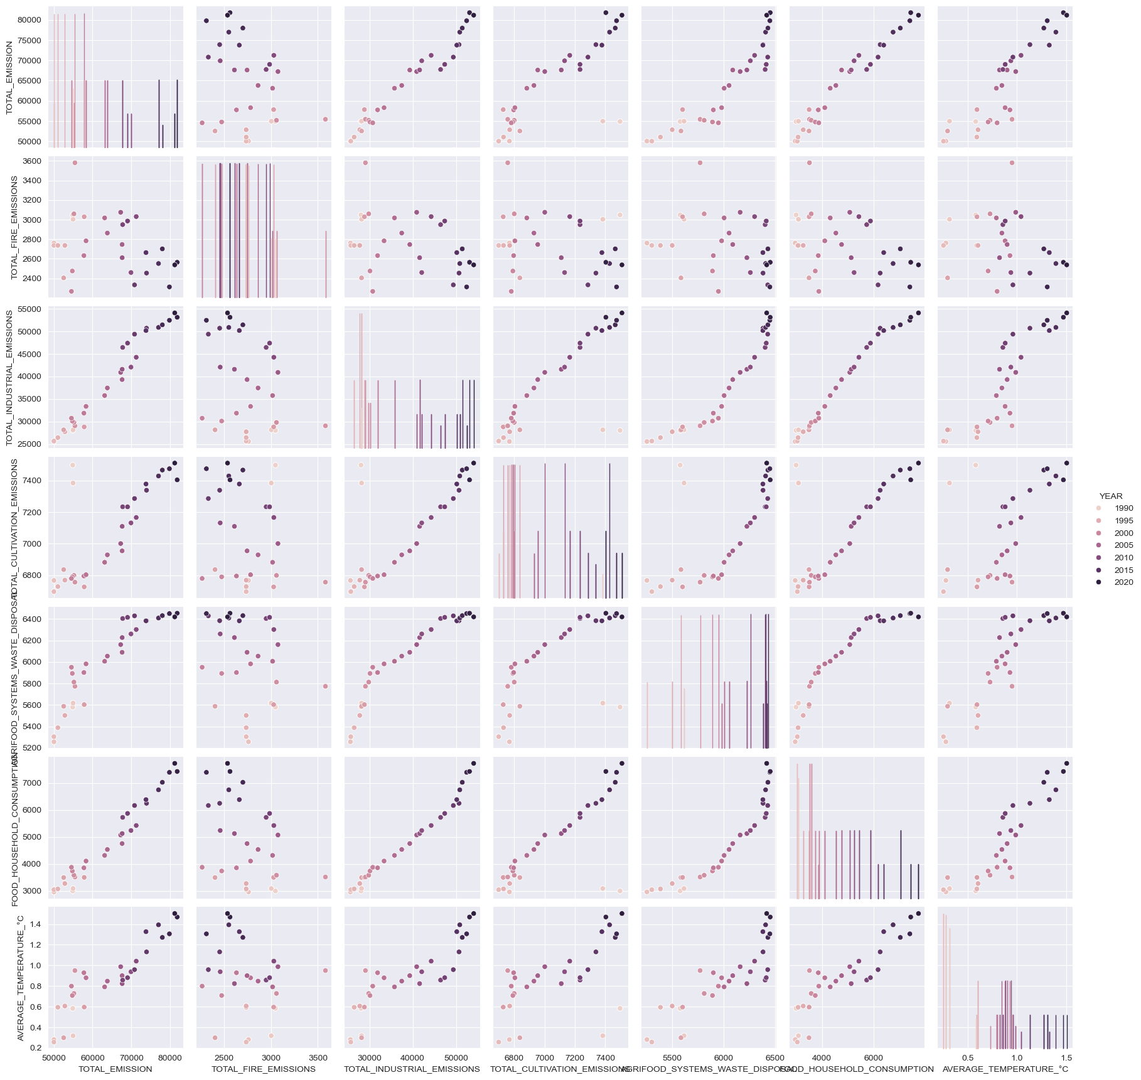

Slide 18
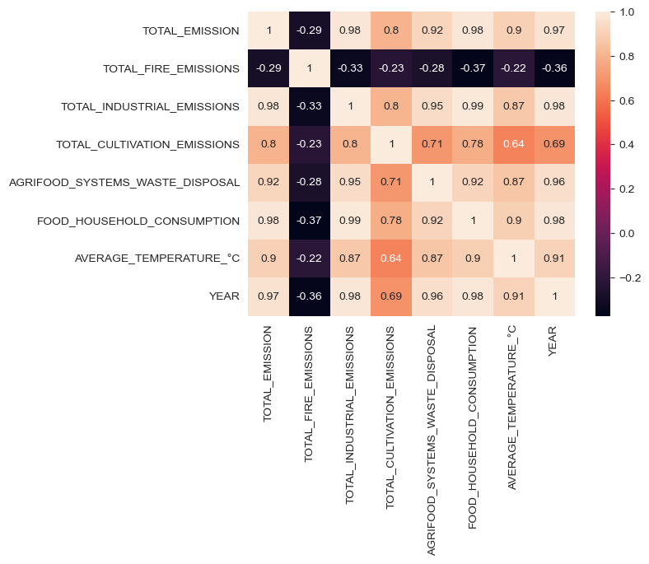
The positive relationship amongst most predictor and Global Temperature is demonstrated in the heatmap above.
The average temperature increase, along with urban population and total emissions showcase an upward trend.
Industrial processes emit the most CO2 in the agri-food sector, while fire emissions the least.
China, India, Brazil and the USA emit the most CO2 from the agri-food sector.
Temperature rise seems to be strongly related to Year and Area.
Fire emissions do not seem to be related to temperature rise.
All agri-food sector processes emissions seem to be strongly, positively related to the increase in the average global temperature.

Slide 19
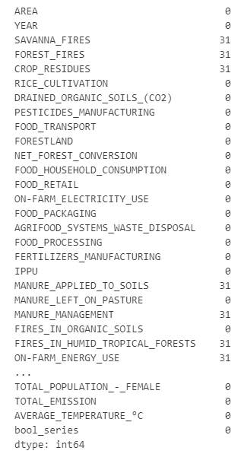
Model evaluation metrics
Model evaluation metrics such as MSE, RMSE, MAE, and R2 are used in this project to measure the performance of predictive models. These metrics show how well a model predicts average temperature rise which assists in selection of the most accurate and reliable model.
Handling Missing Values
Before we can run the models we need to deal with the null values present in our dataset. There are quite a few null values that we need to deal with. It is important to understand whether the null values are null because data was not collected or because there is some meaning into it. We will need to check each variable separately in order for the data to make sense. Let's have a look at the area, maybe it will give us some insight.
The data shows that Holy See is the only area that has no records of Savanna values. This makes sense since it is not possible that such fire events occur in the city of Vatican. We will also need to check what other null values this Area has. It is a special case of an area since many features such as Forest fires, Savanna fires, manure, and tropical forest fires or farms do not exist.
The data shows that those features contain null values because in reality ,they are non-existent in the Holy see therefore we will fill all the null values with 0.

Slide 20
Holy See Snapshot
 | AREA | YEAR | SAVANNA_FIRES | FOREST_FIRES | CROP_RESIDUES | RICE_CULTIVATION | DRAINED_ORGANIC_SOILS_(CO2) | PESTICIDES_MANUFACTURING | FOOD_TRANSPORT | FORESTLAND | ... | FIRES_IN_ORGANIC_SOILS | FIRES_IN_HUMID_TROPICAL_FORESTS | ON-FARM_ENERGY_USE | RURAL_POPULATION | URBAN_POPULATION | TOTAL_POPULATION_-_MALE | TOTAL_POPULATION_-_FEMALE | TOTAL_EMISSION | AVERAGE_TEMPERATURE_°C | bool_series
2835 | Holy See | 1990 | 0.0 | 0.0 | 0.0 | 9616.267306 | 0.0 | 11.481085 | 26.262663 | 0.0 | ... | 0.058149 | 0.0 | 0.0 | 0.0 | 768.0 | 340.0 | 370.0 | 18688.406793 | 0.905583 | TRUE
2836 | Holy See | 1991 | 0.0 | 0.0 | 0.0 | 9654.499823 | 0.0 | 11.481085 | 26.262663 | 0.0 | ... | 0.058149 | 0.0 | 0.0 | 0.0 | 774.0 | 330.0 | 360.0 | 18726.641610 | -0.098083 | TRUE
2837 | Holy See | 1992 | 0.0 | 0.0 | 0.0 | 9616.267306 | 0.0 | 11.481085 | 26.262663 | 0.0 | ... | 0.058149 | 0.0 | 0.0 | 0.0 | 779.0 | 330.0 | 360.0 | 18684.924938 | 0.773167 | TRUE
2838 | Holy See | 1993 | 0.0 | 0.0 | 0.0 | 9616.267306 | 0.0 | 11.481085 | 26.262663 | 0.0 | ... | 0.058149 | 0.0 | 0.0 | 0.0 | 778.0 | 330.0 | 360.0 | 18684.874838 | 0.564417 | TRUE
2839 | Holy See | 1994 | 0.0 | 0.0 | 0.0 | 9649.123125 | 0.0 | 11.481085 | 26.262663 | 0.0 | ... | 0.058149 | 0.0 | 0.0 | 0.0 | 778.0 | 320.0 | 350.0 | 18717.728958 | 1.444500 | TRUE
2840 | Holy See | 1995 | 0.0 | 0.0 | 0.0 | 9687.355642 | 0.0 | 11.481085 | 26.262663 | 0.0 | ... | 0.058149 | 0.0 | 0.0 | 0.0 | 780.0 | 320.0 | 350.0 | 18755.973575 | 0.267167 | TRUE
2841 | Holy See | 1996 | 0.0 | 0.0 | 0.0 | 9687.355642 | 0.0 | 11.481085 | 26.262663 | 0.0 | ... | 0.058149 | 0.0 | 0.0 | 0.0 | 778.0 | 320.0 | 350.0 | 18755.981975 | 0.245167 | TRUE
2842 | Holy See | 1997 | 0.0 | 0.0 | 0.0 | 9649.123125 | 0.0 | 11.481085 | 26.262663 | 0.0 | ... | 0.058149 | 0.0 | 0.0 | 0.0 | 782.0 | 320.0 | 340.0 | 18717.754458 | 0.889583 | TRUE
2843 | Holy See | 1998 | 0.0 | 0.0 | 0.0 | 9649.123125 | 0.0 | 11.481085 | 26.262663 | 0.0 | ... | 0.058149 | 0.0 | 0.0 | 0.0 | 781.0 | 320.0 | 340.0 | 18717.784658 | 0.778250 | TRUE
2844 | Holy See | 1999 | 0.0 | 0.0 | 0.0 | 9649.123125 | 0.0 | 11.481085 | 26.262663 | 0.0 | ... | 0.058149 | 0.0 | 0.0 | 0.0 | 781.0 | 310.0 | 340.0 | 18717.817658 | 0.926500 | TRUE
2845 | Holy See | 2000 | 0.0 | 0.0 | 0.0 | 9649.123125 | 0.0 | 11.481085 | 26.262663 | 0.0 | ... | 0.058149 | 0.0 | 0.0 | 0.0 | 785.0 | 310.0 | 340.0 | 18717.803958 | 1.307583 | TRUE
2846 | Holy See | 2001 | 0.0 | 0.0 | 0.0 | 9649.123125 | 0.0 | 11.481085 | 26.262663 | 0.0 | ... | 0.058149 | 0.0 | 0.0 | 0.0 | 788.0 | 310.0 | 340.0 | 18717.858758 | 1.130750 | TRUE
2847 | Holy See | 2002 | 0.0 | 0.0 | 0.0 | 9649.123125 | 0.0 | 11.481085 | 26.262663 | 0.0 | ... | 0.058149 | 0.0 | 0.0 | 0.0 | 792.0 | 310.0 | 330.0 | 18717.878958 | 1.010250 | TRUE
2848 | Holy See | 2003 | 0.0 | 0.0 | 0.0 | 9649.123125 | 0.0 | 11.481085 | 26.262663 | 0.0 | ... | 0.058149 | 0.0 | 0.0 | 0.0 | 798.0 | 310.0 | 330.0 | 18717.910758 | 1.392250 | TRUE
2849 | Holy See | 2004 | 0.0 | 0.0 | 0.0 | 9649.123125 | 0.0 | 11.481085 | 26.262663 | 0.0 | ... | 0.058149 | 0.0 | 0.0 | 0.0 | 797.0 | 310.0 | 330.0 | 18717.941558 | 0.627250 | TRUE
2850 | Holy See | 2005 | 0.0 | 0.0 | 0.0 | 9687.355642 | 0.0 | 11.481085 | 26.262663 | 0.0 | ... | 0.058149 | 0.0 | 0.0 | 0.0 | 798.0 | 300.0 | 320.0 | 18756.178975 | 0.235500 | TRUE
2851 | Holy See | 2006 | 0.0 | 0.0 | 0.0 | 9649.123125 | 0.0 | 11.481085 | 26.262663 | 0.0 | ... | 0.058149 | 0.0 | 0.0 | 0.0 | 800.0 | 300.0 | 320.0 | 18717.902458 | 0.843833 | TRUE
2852 | Holy See | 2007 | 0.0 | 0.0 | 0.0 | 9649.123125 | 0.0 | 11.481085 | 26.262663 | 0.0 | ... | 0.058149 | 0.0 | 0.0 | 0.0 | 796.0 | 300.0 | 320.0 | 18717.909958 | 1.088917 | TRUE
2853 | Holy See | 2008 | 0.0 | 0.0 | 0.0 | 9649.123125 | 0.0 | 11.481085 | 26.262663 | 0.0 | ... | 0.058149 | 0.0 | 0.0 | 0.0 | 794.0 | 300.0 | 310.0 | 18717.882958 | 1.066000 | TRUE
2854 | Holy See | 2009 | 0.0 | 0.0 | 0.0 | 9649.123125 | 0.0 | 11.481085 | 26.262663 | 0.0 | ... | 0.058149 | 0.0 | 0.0 | 0.0 | 795.0 | 290.0 | 310.0 | 18717.822558 | 1.081000 | TRUE
2855 | Holy See | 2010 | 0.0 | 0.0 | 0.0 | 9649.123125 | 0.0 | 11.481085 | 26.262663 | 0.0 | ... | 0.058149 | 0.0 | 0.0 | 0.0 | 794.0 | 290.0 | 310.0 | 18717.855958 | 0.679250 | TRUE
2856 | Holy See | 2011 | 0.0 | 0.0 | 0.0 | 9649.123125 | 0.0 | 11.481085 | 26.262663 | 0.0 | ... | 0.058149 | 0.0 | 0.0 | 0.0 | 796.0 | 280.0 | 310.0 | 18717.841758 | 1.190000 | TRUE
2857 | Holy See | 2012 | 0.0 | 0.0 | 0.0 | 9649.123125 | 0.0 | 11.481085 | 26.262663 | 0.0 | ... | 0.058149 | 0.0 | 0.0 | 0.0 | 804.0 | 280.0 | 300.0 | 18917.380320 | 1.352167 | TRUE
2858 | Holy See | 2013 | 0.0 | 0.0 | 0.0 | 9649.123125 | 0.0 | 11.481085 | 26.262663 | 0.0 | ... | 0.058149 | 0.0 | 0.0 | 0.0 | 801.0 | 280.0 | 300.0 | 18917.345720 | 0.952000 | TRUE
2859 | Holy See | 2014 | 0.0 | 0.0 | 0.0 | 9649.123125 | 0.0 | 11.481085 | 26.262663 | 0.0 | ... | 0.058149 | 0.0 | 0.0 | 0.0 | 800.0 | 270.0 | 300.0 | 18909.606467 | 1.410667 | TRUE
2860 | Holy See | 2015 | 0.0 | 0.0 | 0.0 | 9649.123125 | 0.0 | 11.481085 | 26.262663 | 0.0 | ... | 0.058149 | 0.0 | 0.0 | 0.0 | 803.0 | 270.0 | 290.0 | 18909.633067 | 1.574667 | TRUE
2861 | Holy See | 2016 | 0.0 | 0.0 | 0.0 | 9649.123125 | 0.0 | 11.481085 | 26.262663 | 0.0 | ... | 0.058149 | 0.0 | 0.0 | 0.0 | 801.0 | 270.0 | 290.0 | 18909.633367 | 1.450667 | TRUE
2862 | Holy See | 2017 | 0.0 | 0.0 | 0.0 | 9649.123125 | 0.0 | 11.481085 | 26.262663 | 0.0 | ... | 0.058149 | 0.0 | 0.0 | 0.0 | 792.0 | 260.0 | 290.0 | 18909.655767 | 1.286000 | TRUE
2863 | Holy See | 2018 | 0.0 | 0.0 | 0.0 | 9649.123125 | 0.0 | 11.481085 | 26.262663 | 0.0 | ... | 0.058149 | 0.0 | 0.0 | 0.0 | 801.0 | 260.0 | 280.0 | 18909.662467 | 1.951333 | TRUE
2864 | Holy See | 2019 | 0.0 | 0.0 | 0.0 | 9649.123125 | 0.0 | 11.481085 | 26.262663 | 0.0 | ... | 0.058149 | 0.0 | 0.0 | 0.0 | 799.0 | 250.0 | 270.0 | 18909.607467 | 1.674917 | TRUE
2865 | Holy See | 2020 | 0.0 | 0.0 | 0.0 | 9649.123125 | 0.0 | 11.481085 | 26.262663 | 0.0 | ... | 0.058149 | 0.0 | 0.0 | 0.0 | 801.0 | 250.0 | 270.0 | 18909.596767 | 1.670583 | TRUE

Slide 21
Forest Fires
The data shows that Monaco and San Marino have null values for Forest fires. After investigating these areas, we conclude that is reasonable that data has null values because there are no forest in those two areas.
 | AREA | YEAR | SAVANNA_FIRES | FOREST_FIRES | CROP_RESIDUES | RICE_CULTIVATION | DRAINED_ORGANIC_SOILS_(CO2) | PESTICIDES_MANUFACTURING | FOOD_TRANSPORT | FORESTLAND | ... | FIRES_IN_ORGANIC_SOILS | FIRES_IN_HUMID_TROPICAL_FORESTS | ON-FARM_ENERGY_USE | RURAL_POPULATION | URBAN_POPULATION | TOTAL_POPULATION_-_MALE | TOTAL_POPULATION_-_FEMALE | TOTAL_EMISSION | AVERAGE_TEMPERATURE_°C | bool_series
4117 | Monaco | 1990 | 0.0 | 0.0 | NaN | 8976.562525 | 0.0 | 11.481085 | 0.0657 | 0.0 | ... | 0.058149 | NaN | NaN | 0.0 | 29439.0 | 14435.0 | 15894.0 | 13617.314148 | 1.026750 | TRUE
4118 | Monaco | 1991 | 0.0 | 0.0 | NaN | 9014.795042 | 0.0 | 11.481085 | 0.0051 | 0.0 | ... | 0.058149 | NaN | NaN | 0.0 | 29624.0 | 14577.0 | 15987.0 | 13204.334274 | 0.223833 | TRUE
4119 | Monaco | 1992 | 0.0 | 0.0 | NaN | 8976.562525 | 0.0 | 11.481085 | 0.0308 | 0.0 | ... | 0.058149 | NaN | NaN | 0.0 | 29863.0 | 14722.0 | 16073.0 | 13618.319948 | 0.757167 | TRUE
4120 | Monaco | 1993 | 0.0 | 0.0 | NaN | 8976.562525 | 0.0 | 11.481085 | 0.0056 | 0.0 | ... | 0.058149 | NaN | NaN | 0.0 | 30138.0 | 14864.0 | 16160.0 | 13619.547048 | 0.493333 | TRUE
4121 | Monaco | 1994 | 0.0 | 0.0 | NaN | 9009.418345 | 0.0 | 11.481085 | 0.0046 | 0.0 | ... | 0.058149 | NaN | NaN | 0.0 | 30427.0 | 15002.0 | 16252.0 | 13651.372368 | 1.346000 | TRUE
... | ... | ... | ... | ... | ... | ... | ... | ... | ... | ... | ... | ... | ... | ... | ... | ... | ... | ... | ... | ... | ...
5505 | San Marino | 2016 | 0.0 | 0.0 | NaN | 9009.418345 | 0.0 | 11.481085 | 0.9472 | 0.0 | ... | 0.058149 | NaN | NaN | 1026.0 | 32177.0 | 16453.0 | 17381.0 | 13666.569235 | 1.684667 | TRUE
5506 | San Marino | 2017 | 0.0 | 0.0 | NaN | 9009.418345 | 0.0 | 11.481085 | 0.9791 | 0.0 | ... | 0.058149 | NaN | NaN | 978.0 | 32422.0 | 16564.0 | 17492.0 | 13667.385535 | 1.665417 | TRUE
5507 | San Marino | 2018 | 0.0 | 0.0 | NaN | 9009.418345 | 0.0 | 11.481085 | 0.9884 | 0.0 | ... | 0.058149 | NaN | NaN | 931.0 | 32626.0 | 16626.0 | 17530.0 | 13667.433635 | 2.006417 | TRUE
5508 | San Marino | 2019 | 0.0 | 0.0 | NaN | 9009.418345 | 0.0 | 11.481085 | 0.9953 | 0.0 | ... | 0.058149 | NaN | NaN | 887.0 | 32796.0 | 16650.0 | 17527.0 | 13665.698735 | 1.968583 | TRUE
5509 | San Marino | 2020 | 0.0 | 0.0 | NaN | 9009.418345 | 0.0 | 11.481085 | 1.0153 | 0.0 | ... | 0.058149 | NaN | NaN | 846.0 | 32963.0 | 16563.0 | 17444.0 | 13665.543035 | 1.913083 | TRUE

Slide 22
Fires in the Humid Tropical Forests
 | AREA | YEAR | SAVANNA_FIRES | FOREST_FIRES | CROP_RESIDUES | RICE_CULTIVATION | DRAINED_ORGANIC_SOILS_(CO2) | PESTICIDES_MANUFACTURING | FOOD_TRANSPORT | FORESTLAND | ... | FIRES_IN_ORGANIC_SOILS | FIRES_IN_HUMID_TROPICAL_FORESTS | ON-FARM_ENERGY_USE | RURAL_POPULATION | URBAN_POPULATION | TOTAL_POPULATION_-_MALE | TOTAL_POPULATION_-_FEMALE | TOTAL_EMISSION | AVERAGE_TEMPERATURE_°C | bool_series
4117 | Monaco | 1990 | 0.0 | 0.0 | NaN | 8976.562525 | 0.0 | 11.481085 | 0.0657 | 0.0 | ... | 0.058149 | NaN | NaN | 0.0 | 29439.0 | 14435.0 | 15894.0 | 13617.314148 | 1.026750 | TRUE
4118 | Monaco | 1991 | 0.0 | 0.0 | NaN | 9014.795042 | 0.0 | 11.481085 | 0.0051 | 0.0 | ... | 0.058149 | NaN | NaN | 0.0 | 29624.0 | 14577.0 | 15987.0 | 13204.334274 | 0.223833 | TRUE
4119 | Monaco | 1992 | 0.0 | 0.0 | NaN | 8976.562525 | 0.0 | 11.481085 | 0.0308 | 0.0 | ... | 0.058149 | NaN | NaN | 0.0 | 29863.0 | 14722.0 | 16073.0 | 13618.319948 | 0.757167 | TRUE
4120 | Monaco | 1993 | 0.0 | 0.0 | NaN | 8976.562525 | 0.0 | 11.481085 | 0.0056 | 0.0 | ... | 0.058149 | NaN | NaN | 0.0 | 30138.0 | 14864.0 | 16160.0 | 13619.547048 | 0.493333 | TRUE
4121 | Monaco | 1994 | 0.0 | 0.0 | NaN | 9009.418345 | 0.0 | 11.481085 | 0.0046 | 0.0 | ... | 0.058149 | NaN | NaN | 0.0 | 30427.0 | 15002.0 | 16252.0 | 13651.372368 | 1.346000 | TRUE
... | ... | ... | ... | ... | ... | ... | ... | ... | ... | ... | ... | ... | ... | ... | ... | ... | ... | ... | ... | ... | ...
5505 | San Marino | 2016 | 0.0 | 0.0 | NaN | 9009.418345 | 0.0 | 11.481085 | 0.9472 | 0.0 | ... | 0.058149 | NaN | NaN | 1026.0 | 32177.0 | 16453.0 | 17381.0 | 13666.569235 | 1.684667 | TRUE
5506 | San Marino | 2017 | 0.0 | 0.0 | NaN | 9009.418345 | 0.0 | 11.481085 | 0.9791 | 0.0 | ... | 0.058149 | NaN | NaN | 978.0 | 32422.0 | 16564.0 | 17492.0 | 13667.385535 | 1.665417 | TRUE
5507 | San Marino | 2018 | 0.0 | 0.0 | NaN | 9009.418345 | 0.0 | 11.481085 | 0.9884 | 0.0 | ... | 0.058149 | NaN | NaN | 931.0 | 32626.0 | 16626.0 | 17530.0 | 13667.433635 | 2.006417 | TRUE
5508 | San Marino | 2019 | 0.0 | 0.0 | NaN | 9009.418345 | 0.0 | 11.481085 | 0.9953 | 0.0 | ... | 0.058149 | NaN | NaN | 887.0 | 32796.0 | 16650.0 | 17527.0 | 13665.698735 | 1.968583 | TRUE
5509 | San Marino | 2020 | 0.0 | 0.0 | NaN | 9009.418345 | 0.0 | 11.481085 | 1.0153 | 0.0 | ... | 0.058149 | NaN | NaN | 846.0 | 32963.0 | 16563.0 | 17444.0 | 13665.543035 | 1.913083 | TRUE
Those 4 areas do not have humid tropical forest and hence the null values will be replaced to 0.
We have identified all the missing values that can be filled reasonably(MNAR - Missing Data Not at Random) and have corrected them. The rest of the variables include many missing values, most probably because there are simply no such records present in the dataset at random (MAR - Missing Data at Random). We will use linear regression under the MICE (Multiple Imputation by Chained Equation) framework to fill the rest of the missing values.

Slide 23
MNAR
 | YEAR | SAVANNA_FIRES | FOREST_FIRES | CROP_RESIDUES | RICE_CULTIVATION | DRAINED_ORGANIC_SOILS_(CO2) | PESTICIDES_MANUFACTURING | FOOD_TRANSPORT | FORESTLAND | NET_FOREST_CONVERSION | ... | MANURE_MANAGEMENT | FIRES_IN_ORGANIC_SOILS | FIRES_IN_HUMID_TROPICAL_FORESTS | ON-FARM_ENERGY_USE | RURAL_POPULATION | URBAN_POPULATION | TOTAL_POPULATION_-_MALE | TOTAL_POPULATION_-_FEMALE | TOTAL_EMISSION | AVERAGE_TEMPERATURE_°C
0 | 1990.0 | 14.7237 | 0.0557 | 205.6077 | 686.0000 | 0.0 | 11.807483 | 63.1152 | -2388.8030 | 0.0000 | ... | 319.1763 | 0.0 | 0.0 | 296.186848 | 9655167.0 | 2593947.0 | 5348387.0 | 5346409.0 | 2198.963539 | 0.536167
1 | 1991.0 | 14.7237 | 0.0557 | 209.4971 | 678.1600 | 0.0 | 11.712073 | 61.2125 | -2388.8030 | 0.0000 | ... | 342.3079 | 0.0 | 0.0 | 401.193840 | 10230490.0 | 2763167.0 | 5372959.0 | 5372208.0 | 2323.876629 | 0.020667
2 | 1992.0 | 14.7237 | 0.0557 | 196.5341 | 686.0000 | 0.0 | 11.712073 | 53.3170 | -2388.8030 | 0.0000 | ... | 349.1224 | 0.0 | 0.0 | 433.722746 | 10995568.0 | 2985663.0 | 6028494.0 | 6028939.0 | 2356.304229 | -0.259583
3 | 1993.0 | 14.7237 | 0.0557 | 230.8175 | 686.0000 | 0.0 | 11.712073 | 54.3617 | -2388.8030 | 0.0000 | ... | 352.2947 | 0.0 | 0.0 | 353.985718 | 11858090.0 | 3237009.0 | 7003641.0 | 7000119.0 | 2368.470529 | 0.101917
4 | 1994.0 | 14.7237 | 0.0557 | 242.0494 | 705.6000 | 0.0 | 11.712073 | 53.9874 | -2388.8030 | 0.0000 | ... | 367.6784 | 0.0 | 0.0 | 303.318574 | 12690115.0 | 3482604.0 | 7733458.0 | 7722096.0 | 2500.768729 | 0.372250
... | ... | ... | ... | ... | ... | ... | ... | ... | ... | ... | ... | ... | ... | ... | ... | ... | ... | ... | ... | ... | ...
6960 | 2016.0 | 1190.0089 | 232.5068 | 70.9451 | 7.4088 | 0.0 | 75.000000 | 251.1465 | 76500.2982 | 10662.4408 | ... | 282.5994 | 0.0 | 0.0 | 417.315000 | 10934468.0 | 5215894.0 | 6796658.0 | 7656047.0 | 98491.026347 | 1.120250
6961 | 2017.0 | 1431.1407 | 131.1324 | 108.6262 | 7.9458 | 0.0 | 67.000000 | 255.7975 | 76500.2982 | 10662.4408 | ... | 255.5900 | 0.0 | 0.0 | 398.164400 | 11201138.0 | 5328766.0 | 6940631.0 | 7810471.0 | 97159.311553 | 0.046500
6962 | 2018.0 | 1557.5830 | 221.6222 | 109.9835 | 8.1399 | 0.0 | 66.000000 | 327.0897 | 76500.2982 | 10662.4408 | ... | 257.2735 | 0.0 | 0.0 | 465.773500 | 11465748.0 | 5447513.0 | 7086002.0 | 7966181.0 | 97668.308205 | 0.516333
6963 | 2019.0 | 1591.6049 | 171.0262 | 45.4574 | 7.8322 | 0.0 | 73.000000 | 290.1893 | 76500.2982 | 10662.4408 | ... | 267.5224 | 0.0 | 0.0 | 444.233500 | 11725970.0 | 5571525.0 | 7231989.0 | 8122618.0 | 98988.062799 | 0.985667
6964 | 2020.0 | 481.9027 | 48.4197 | 108.3022 | 7.9733 | 0.0 | 73.000000 | 238.7639 | 76500.2982 | 10662.4408 | ... | 266.7316 | 0.0 | 0.0 | 444.233500 | 11980005.0 | 5700460.0 | 7385220.0 | 8284447.0 | 96505.221853 | 0.189000
6965 rows × 30 columns

Slide 24

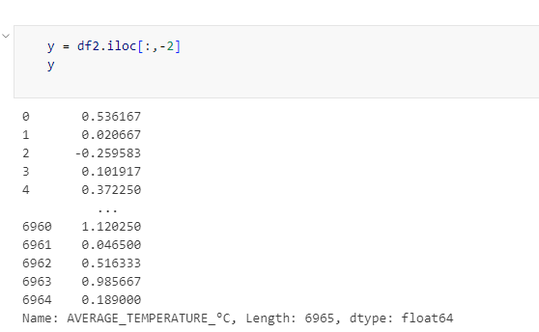


Perform Train tail test

Slide 25
Comparative Analysis
From the above results of models performances, Linear Regression is the most
accurate model with lowest MSE, RMSE and MAE values and R-squared with value 1. This model has perfect accuracy for temperature rise predictions.
Random forest slightly outperforms decision tree in terms of Mean Absolute Error but has a slightly higher Mean Squared Error and RMSE.
Random forest and decision tree both perform very well, with R-squared scores close to 1, indicating strong predictive power.
Conclusion
There are significant results and benefits from the findings of this project for environmental policy and strategic planning . The Linear regression model stands out as a reliable tool with its accurate prediction of temperature rise globally. This helps policymakers for forecasting and managing future temperature rise. Furthermore, the identification and implementation of effective strategies by stakeholders that target emissions can reduce global temperature increase. To conclude, this project successfully implemented data mining techniques for predictive analysis of temperature increase from CO2 emission from agri-food activities with the historic data from the globe. Further the project showed the relationship between CO2 emission, agri-food activities and temperature rise and identified Linear Regression as the most robust model in prediction of temperature rise in the agri-food sector. This implies that reliable predictive models are crucial for making successful policy and climate strategies.

